Slide 1

Parallel Computing
CSC4010
David Cutting – d.cutting@qub.ac.uk

Slide 2
Introduction to Parallel Computing

Slide 3
Parallel Computing
“Parallel computing is a type of computation in which many calculations or processes are carried out simultaneously.” – Wikipedia
“In the simplest sense, parallel computing is the simultaneous use of multiple compute resources to solve a computational problem.” – LLNL

Slide 4
Parallel Computing
“Parallel computing is a type of computation in which many calculations or processes are carried out simultaneously.” – Wikipedia
“In the simplest sense, parallel computing is the simultaneous use of multiple compute resources to solve a computational problem.” – LLNL

Slide 5
Serial (or Sequential) Computing
A problem is broken down into a series of instructions (tasks) which are serially (sequentially) executed one after the other
Traditional way for computer programs to run (multi-tasking was an illusion with fast context switching for a long time on PCs)
Even with multi-core/multi-thread environments a single program traditionally used a single path of execution aka serial execution

Slide 6
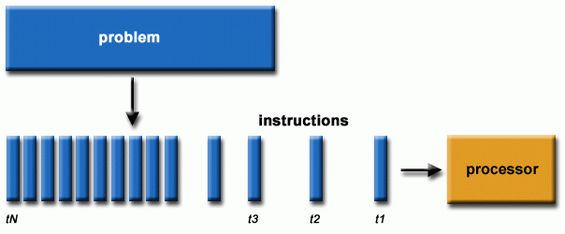
Serial Computing
Source: hpc.llnl.gov

Slide 7
Parallel Computing
A problem is broken into discrete components that can be solved concurrently
Each component is broken down into a series of instructions (tasks)
These tasks are executed simultaneously in different [threads / processes / sequences] of execution
A coordination mechanism is used to manage execution and results

Slide 8
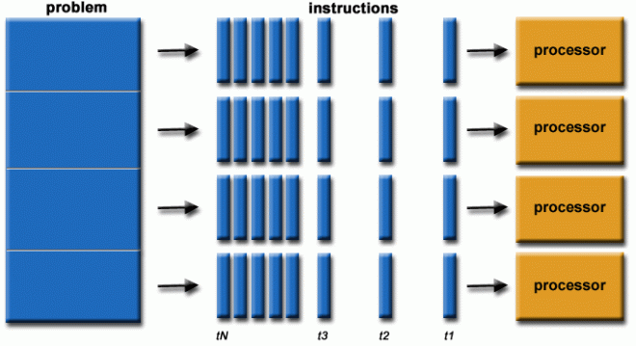
Parallel Computing
Source: hpc.llnl.gov

Slide 9
Why Parallel?
Traditional silicon can only execute so quickly (physical limits such as the pesky speed of light) – note: clock speeds are not increasing but computing power still is
So multiple cores are available (all modern computers are parallel computers)
Writing our code to take advantage of this gives a great advantage for speed and efficiency (GPUs have worked like this for a while!)

Slide 10
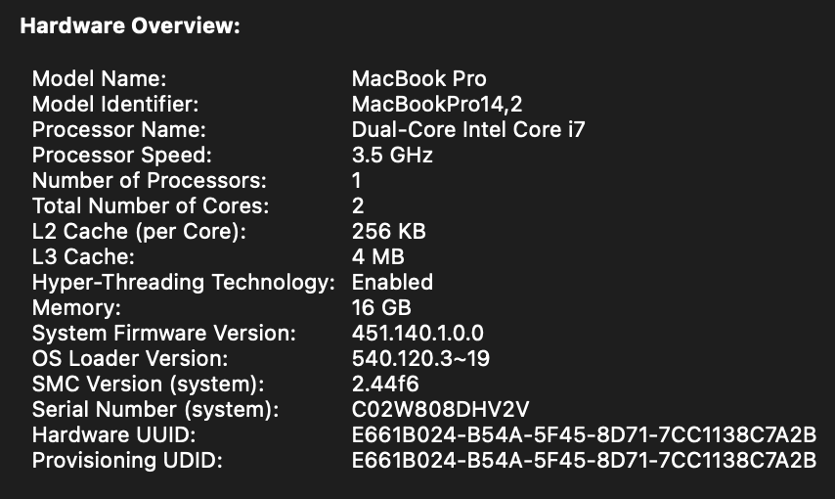
My previous (2017) MBP laptop

Slide 11
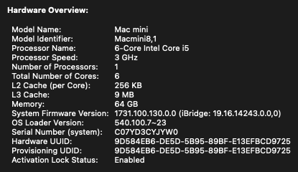
My home office Mac Mini (i5)

Slide 12
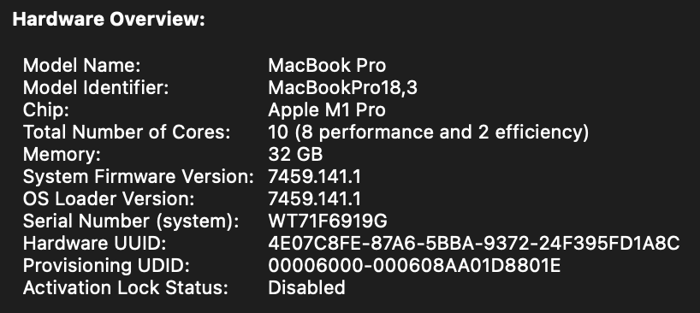
My previous (2021) laptop – MBP M1

Slide 13
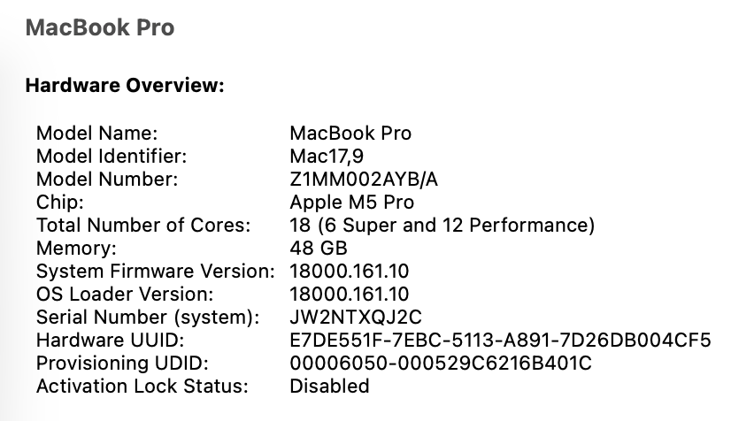
My current laptop – MBP M5

Slide 14
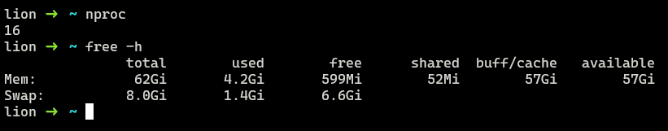
My current home server – AMD Ryzen 7

Slide 15
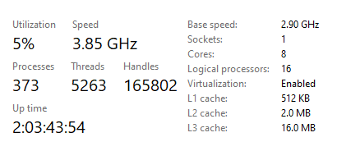
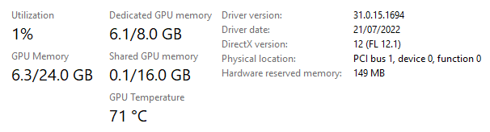
My current Windows PC

Slide 16
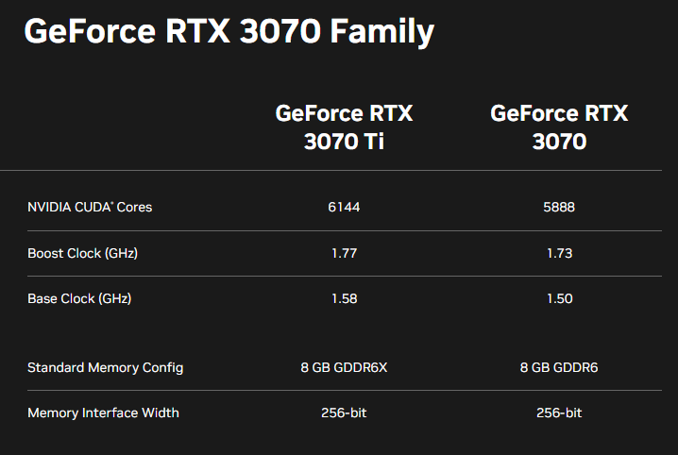
My current Windows PC

Slide 17
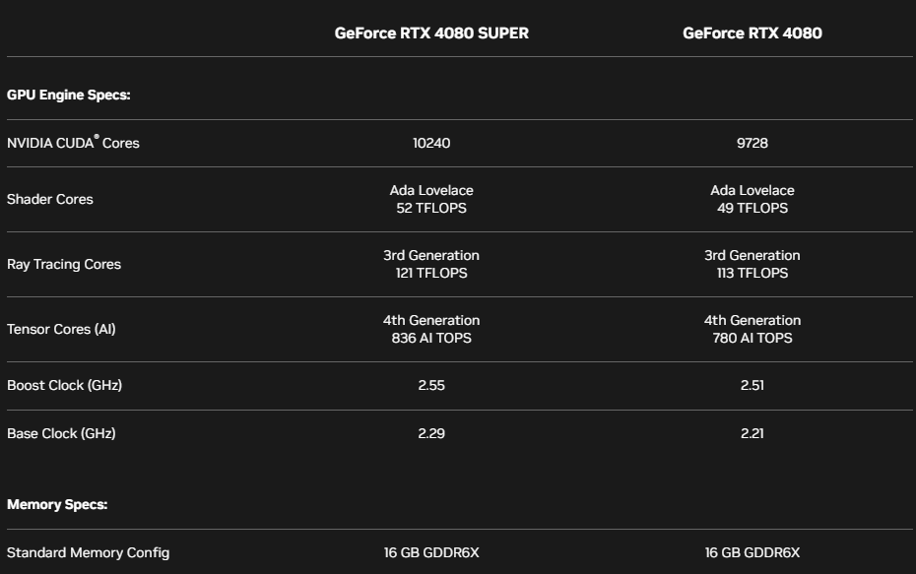
My current Windows PC

Slide 18
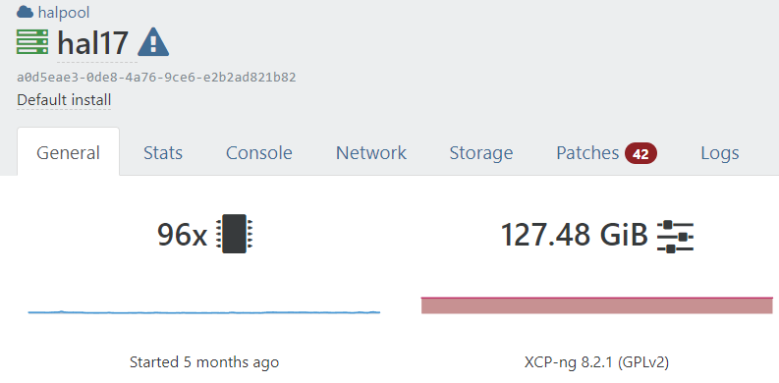
One of our cloud servers (VM host – AMD EPYC)

Slide 19


Slide 20
2 x Xeon 4316 (20 cores with hyperthreading HT)
80 threads of execution
256 GB RAM
Integrated Graphics
1 x AMD Ryzen 5 8400F (6 cores with simultaneous multithreading SMT)
12 threads of execution
64 GB RAM
NVIDIA RTX 5090 GPU (21,760 CUDA cores, 32 GB GDDR7 RAM)

Slide 21
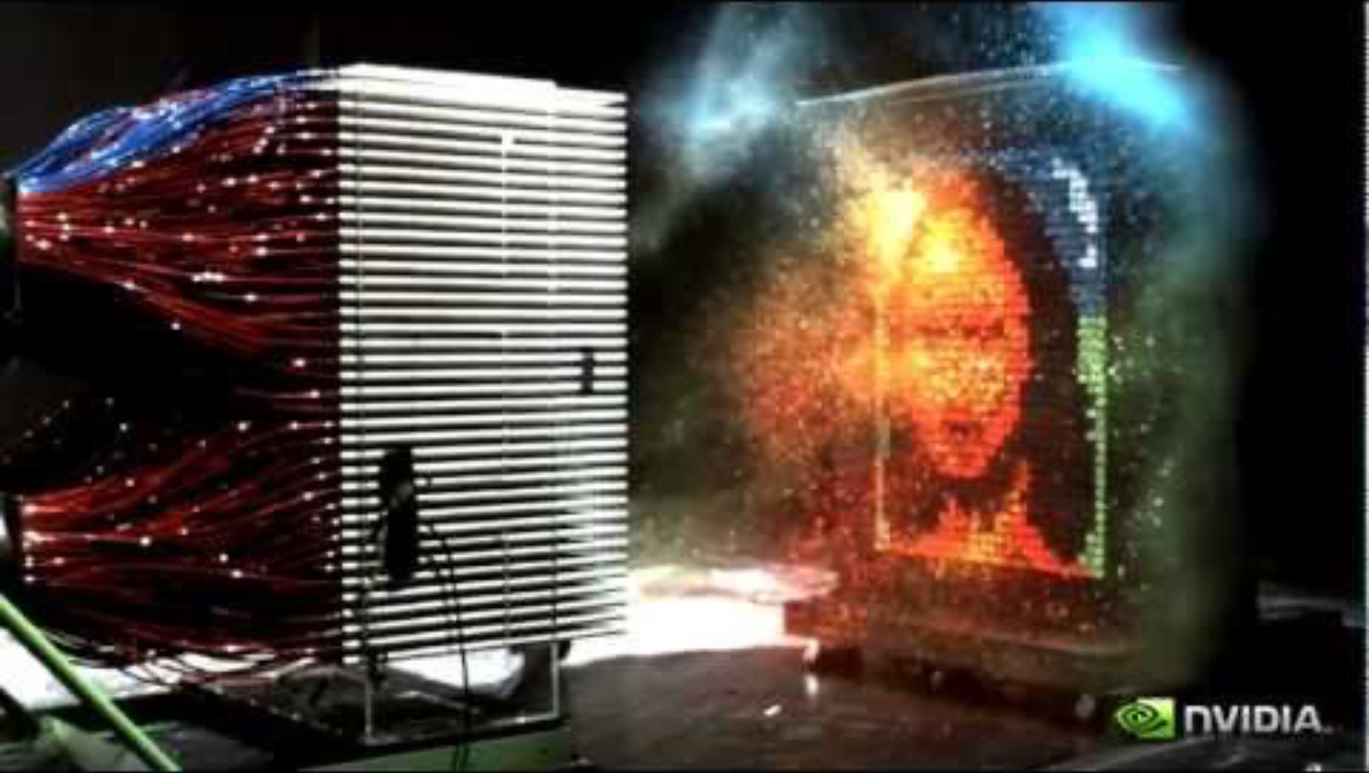

Slide 22
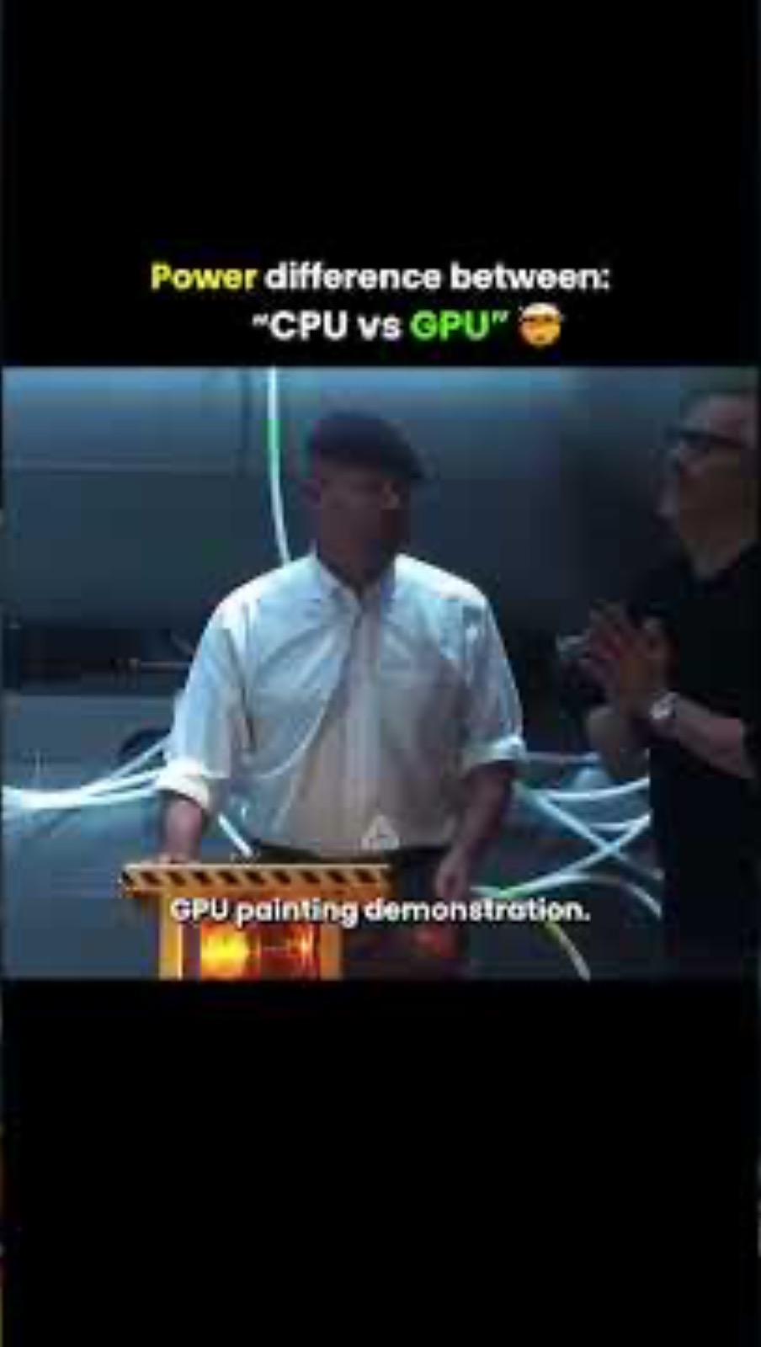

Slide 23
Are all problems parallelisable?

Slide 24
Are all problems parallelisable?
No – or certainly not in totality

Slide 25
Embarrassingly Parallel
A problem where little or no effort is required to separate the problem into a number of parallel tasks
A.K.A. Perfectly Parallel, Delightfully Parallel, Pleasingly Parallel
For example; algorithms where data points are calculated independently

Slide 26
Are these embarrassing?
Set of squares of numbers in a set
Fibonnaci number at a given position
Weather simulation using multiple models
Making a cup of tea

Slide 27
Pros and Cons of Parallel Computing

Slide 28
Pros and Cons of Parallel Computing
Pros
Faster throughput
More efficient use of resources and modern architectures
…
Cons
Requires suitable problems and re-engineering
Specific coding with issues avoided (race conditions etc)
Coordination overhead
…

Slide 29
Let’s have a go…

Slide 30
Flynn’s Taxonomy
(other Taxonomies exist… because it wouldn’t be CS without them!)

Slide 31
Flynn’s Taxonomy
Proposed by Michael J. Flynn in 1966
Used as a tool in design and definition of modern processors and extended functionalities
Instruction stream: order of commands (instructions)
Data stream: set of data in memory to operate upon
Each can be either Single or Multiple

Slide 32
Flynn’s Taxonomy:
XXXX
S I S D
Single Instruction
Single Data
SIMD
Single Instruction
Multiple Data
M I S D
Multiple Instruction
Single Data
M I M D
Multiple Instruction
Multiple Data

Slide 33
Flynn’s Taxonomy:
SISD
S I S D
Single Instruction
Single Data
S I M D
Single Instruction
Multiple Data
M I S D
Multiple Instruction
Single Data
M I M D
Multiple Instruction
Multiple Data
Single Instruction Single Data (SISD)
Each clock cycle the CPU is only acting on one instruction stream and only one data stream is being used
Single processor/core PCs (and older single thread of execution workstations etc)

Slide 34
Flynn’s Taxonomy:
SIMD
S I S D
Single Instruction
Single Data
S I M D
Single Instruction
Multiple Data
M I S D
Multiple Instruction
Single Data
M I M D
Multiple Instruction
Multiple Data
Single Instruction Multiple Data
All CPUs execute the same instruction at any given block cycle but each can be operating on a different data element
Most modern GPU architectures employ SIMD (or elements of SIMD along with MIMD)

Slide 35
Flynn’s Taxonomy:
MISD
S I S D
Single Instruction
Single Data
S I M D
Single Instruction
Multiple Data
M I S D
Multiple Instruction
Single Data
M I M D
Multiple Instruction
Multiple Data
Multiple Instruction Single Data
Each CPU can be executing a different instruction stream but for a common data stream (the same data stream is sent to each CPU but the work performed can be different)
Rare but theoretical use for multiple-model attempts at the same data for example (stream filtering etc)

Slide 36
Flynn’s Taxonomy:
MIMD
S I S D
Single Instruction
Single Data
S I M D
Single Instruction
Multiple Data
M I S D
Multiple Instruction
Single Data
M I M D
Multiple Instruction
Multiple Data
Multiple Instruction Multiple Data
Every CPU may be executing a different set of instructions (stream) and may be working with different data
The most common form of parallel computing
MIMD can include SIMD sub-components

Slide 37

?
?
?
?
?
?
?
?
?
?
?

